Slide 1
IMAGE TO TEXT CONVERTER
PYTHON REVIEW 2

Slide 2
DESIGN OF THE PROJECT
IMAGE TO TEXT CONVERTER

Slide 3
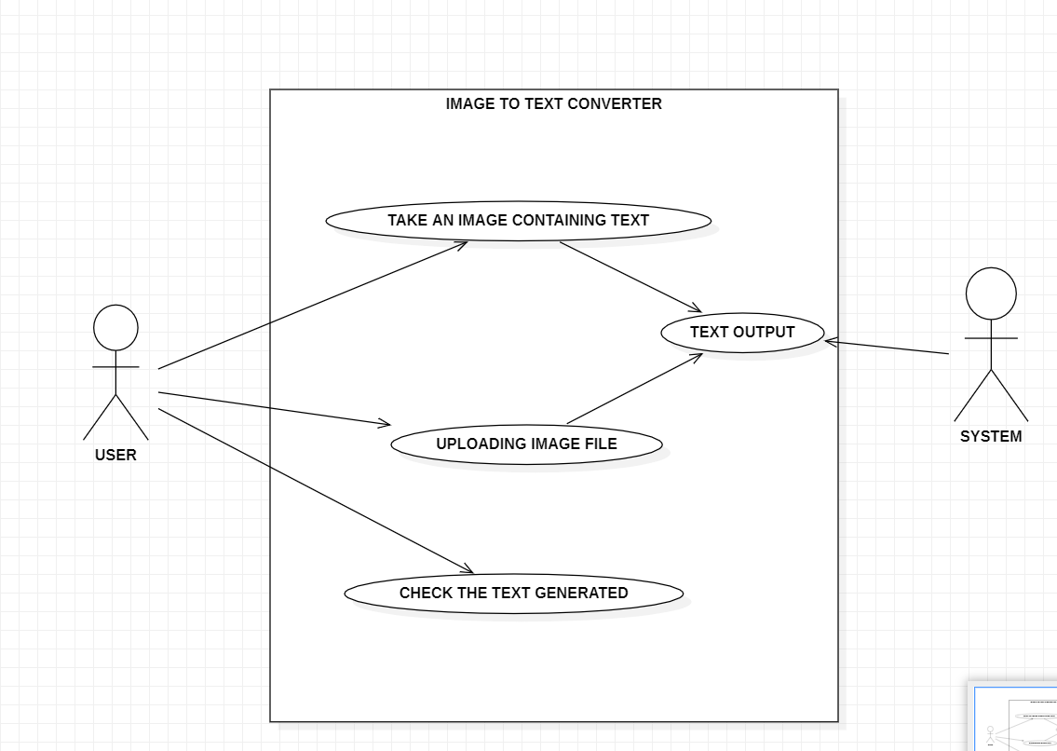
USE CASE DIAGRAM:

Slide 4
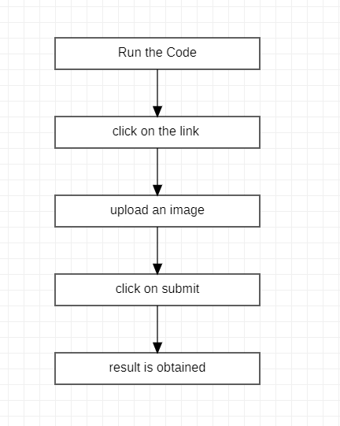
Flowchart of the process:

Slide 5
IMPLEMENTATION of the project
Creating a web application to generate text from an image in Python involves several steps. We'll use Flask, a popular web framework for Python, and an Optical Character Recognition (OCR) library called Tesseract to perform the text extraction from images. Follow the steps below to set up the application:
Step 1: Install the required libraries Make sure you have Python installed on your system. Install the necessary libraries using pip:
“pip install Flask pytesseract pillow”
Additionally, you need to have Tesseract OCR installed. You can download it from the following link: “https://github.com/tesseract-ocr/tesseract”
Step 2: Create the Flask application Create a new Python file, main.py, and add the Python code
Step 3: Create HTML templates Create two HTML templates, index.html, and result.html, in a folder named templates inside your project directory.

Slide 6

Step 4: Run the Flask application Run the Flask application by executing the following command in your terminal or command prompt:
“python app.py”
The application will start, and you should be able to access it at http://127.0.0.1:5000/ in your web browser. Upload an image (JPEG or PNG) containing text, and the application will extract and display the text from the image on the result page.

Slide 7
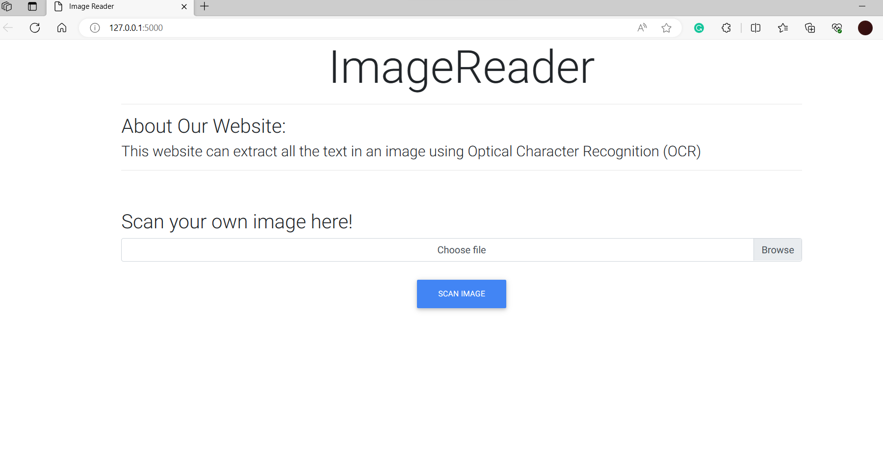
OUTPUT OF PROJECT

Slide 8
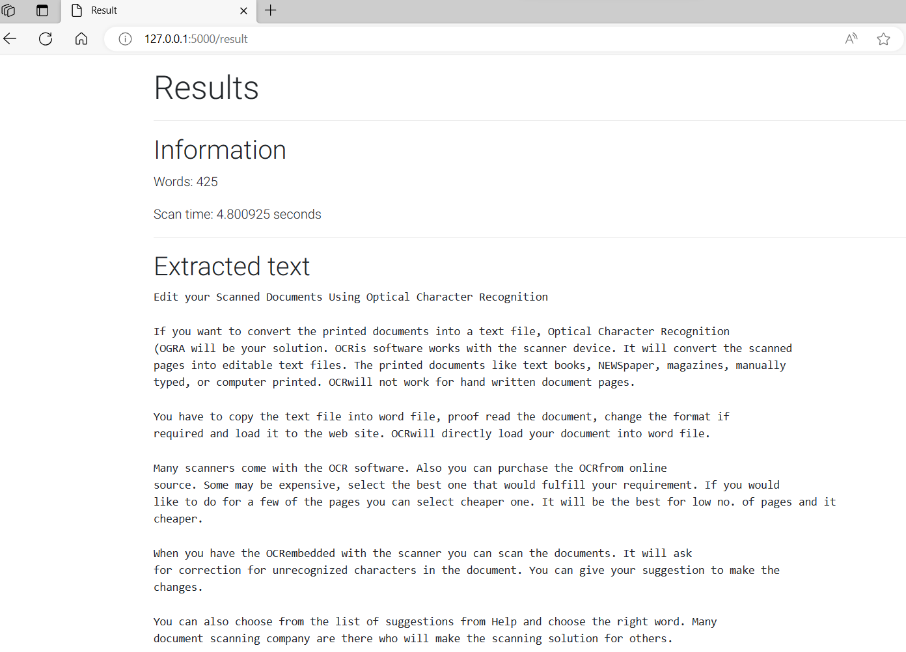

Slide 9
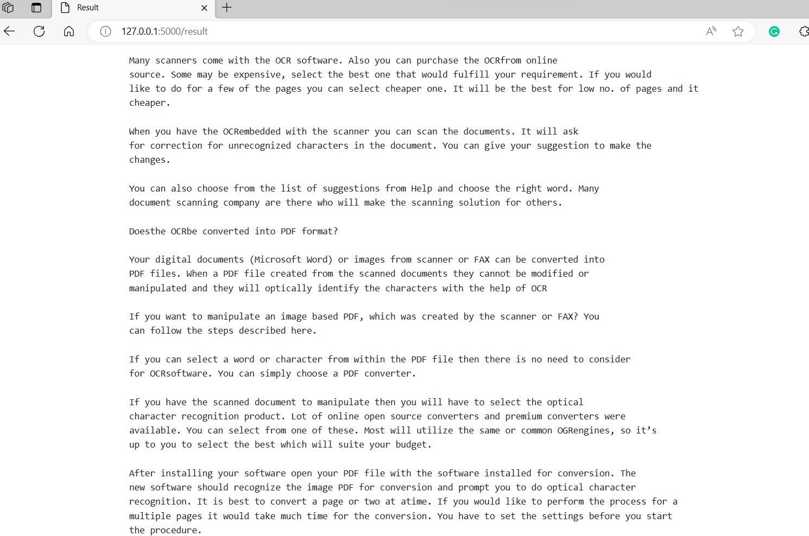

Slide 10
Thank You

